Slide 1
CSE326 : Mock UI
UniForum
An all-in-one platform for University specific discussion, announcement, Q&A
1805018 - MD Rownak Sahanawaz
1805031 - Nahian Shabab
1805043 - Arup Debnath
1805044 - Md. Misbahul Hasan Jinan
1805059 - Md Mehedi Al Masud
1805060 - Shamim Al-Mamun
Presented by 1805031 - Nahian Shabab

Slide 2
Homepage

Slide 3
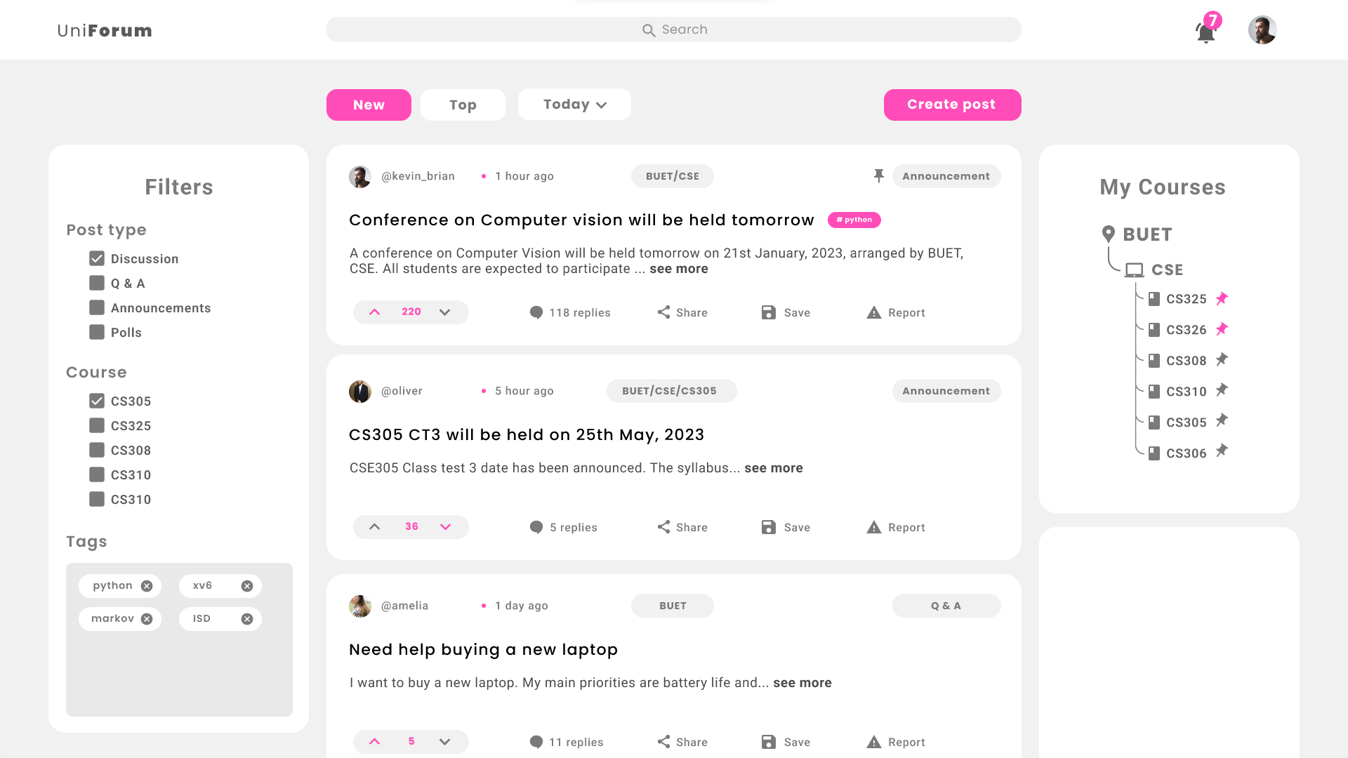

Slide 4


Slide 5
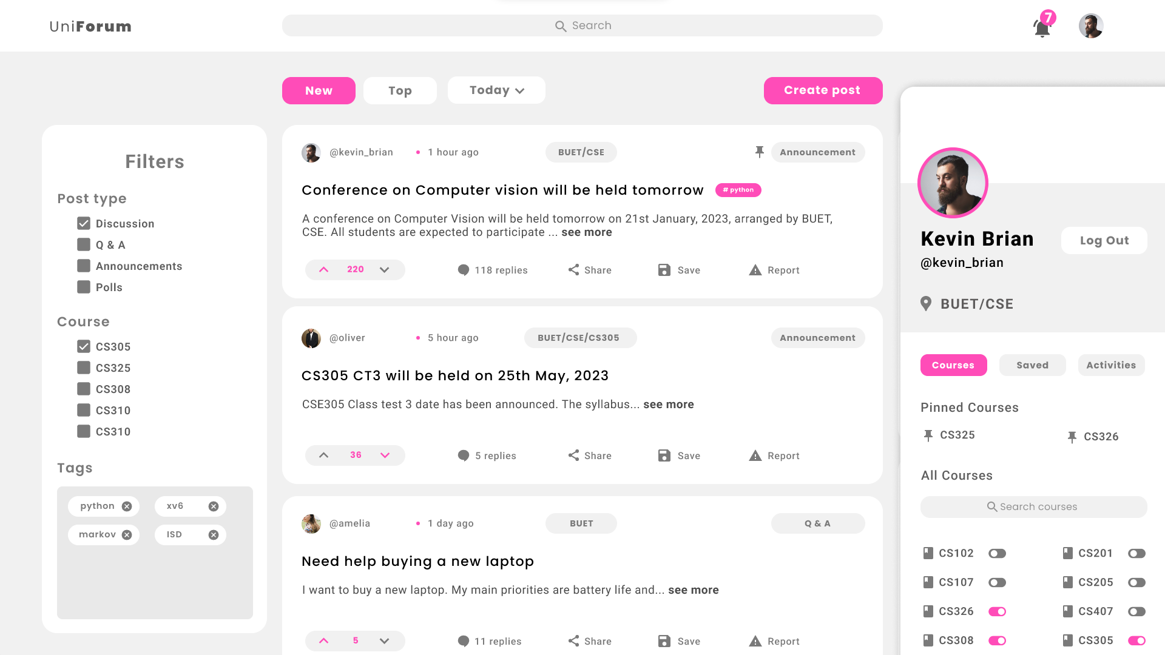

Slide 6
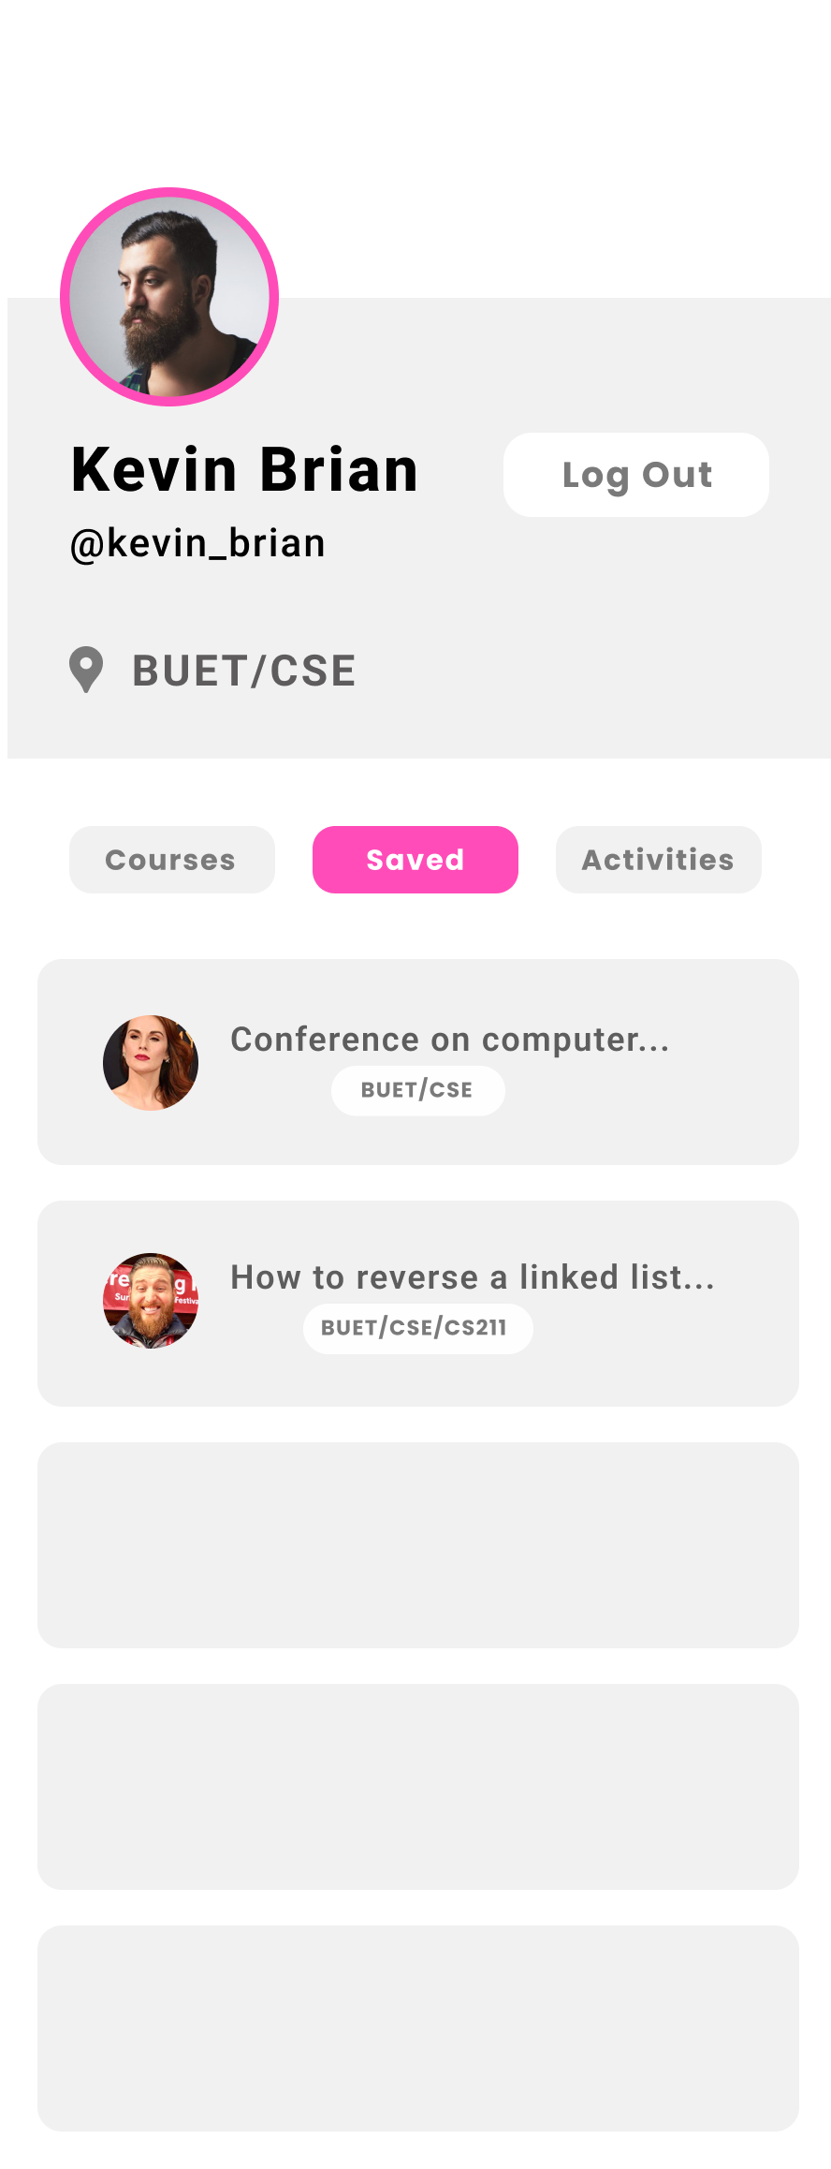

Slide 7
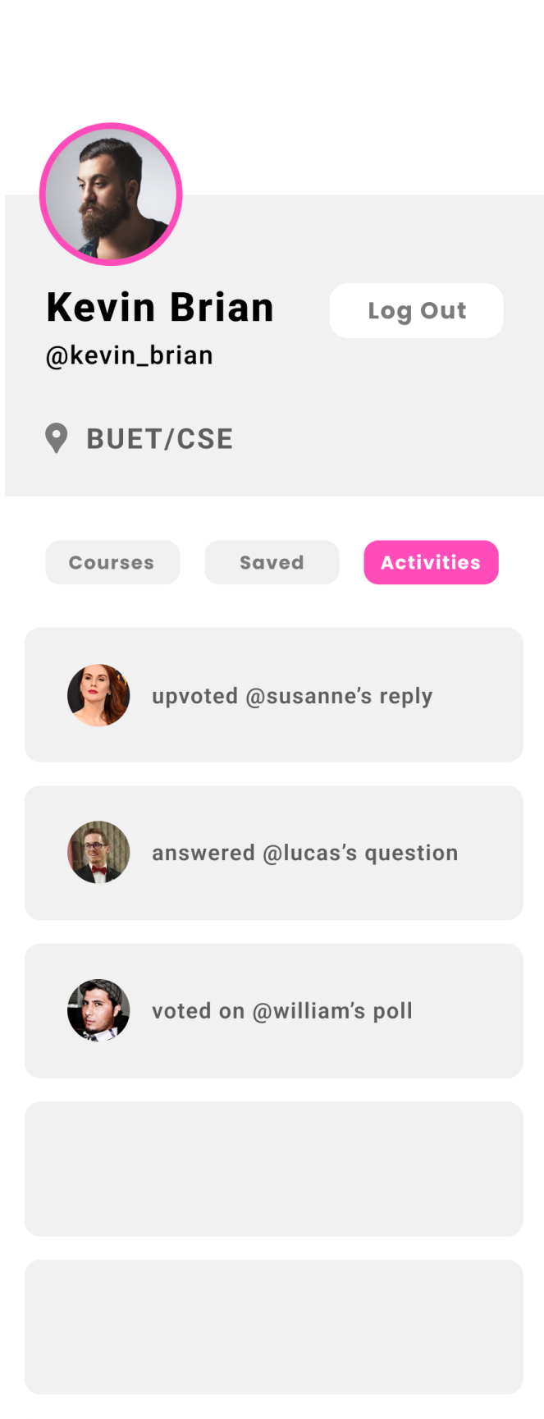

Slide 8


Slide 9
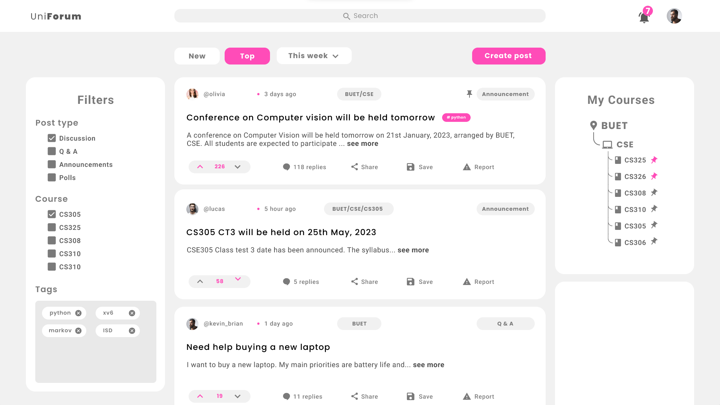

Slide 10
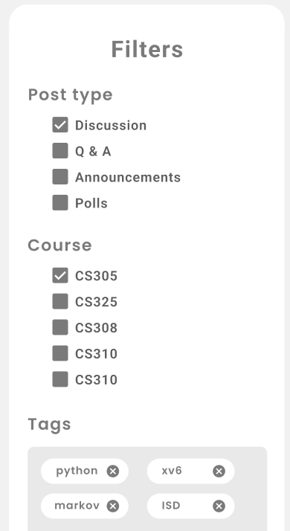


Filtering and Sorting

Slide 11
Search

Slide 12
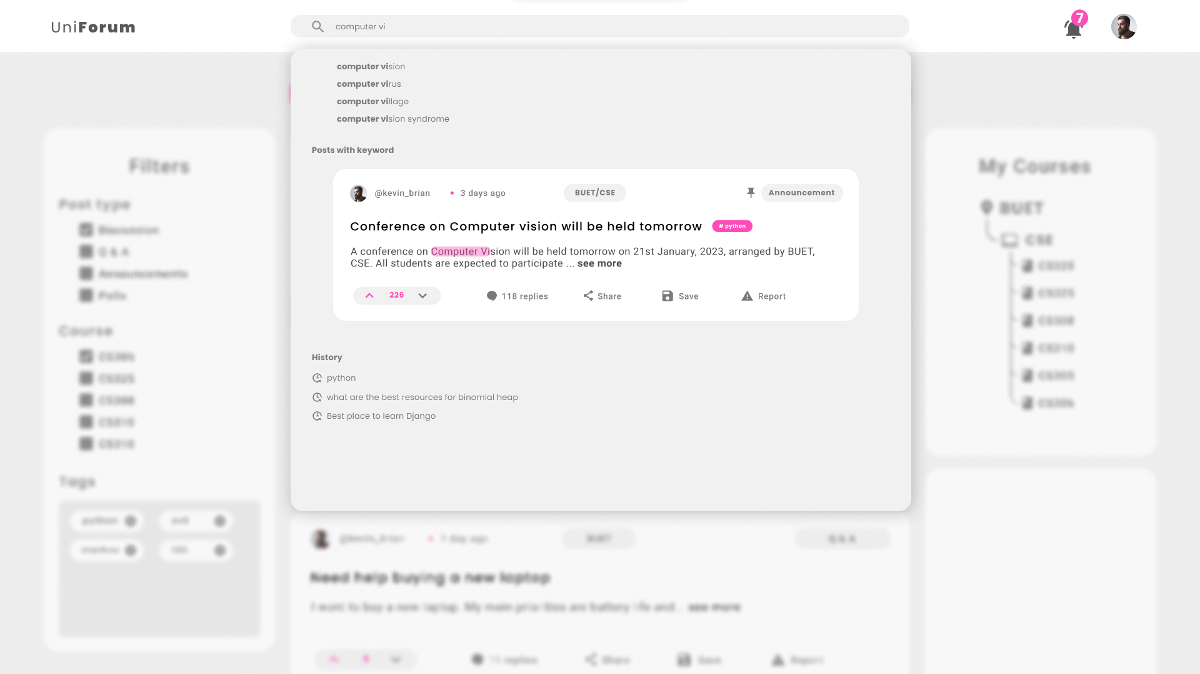

Slide 13
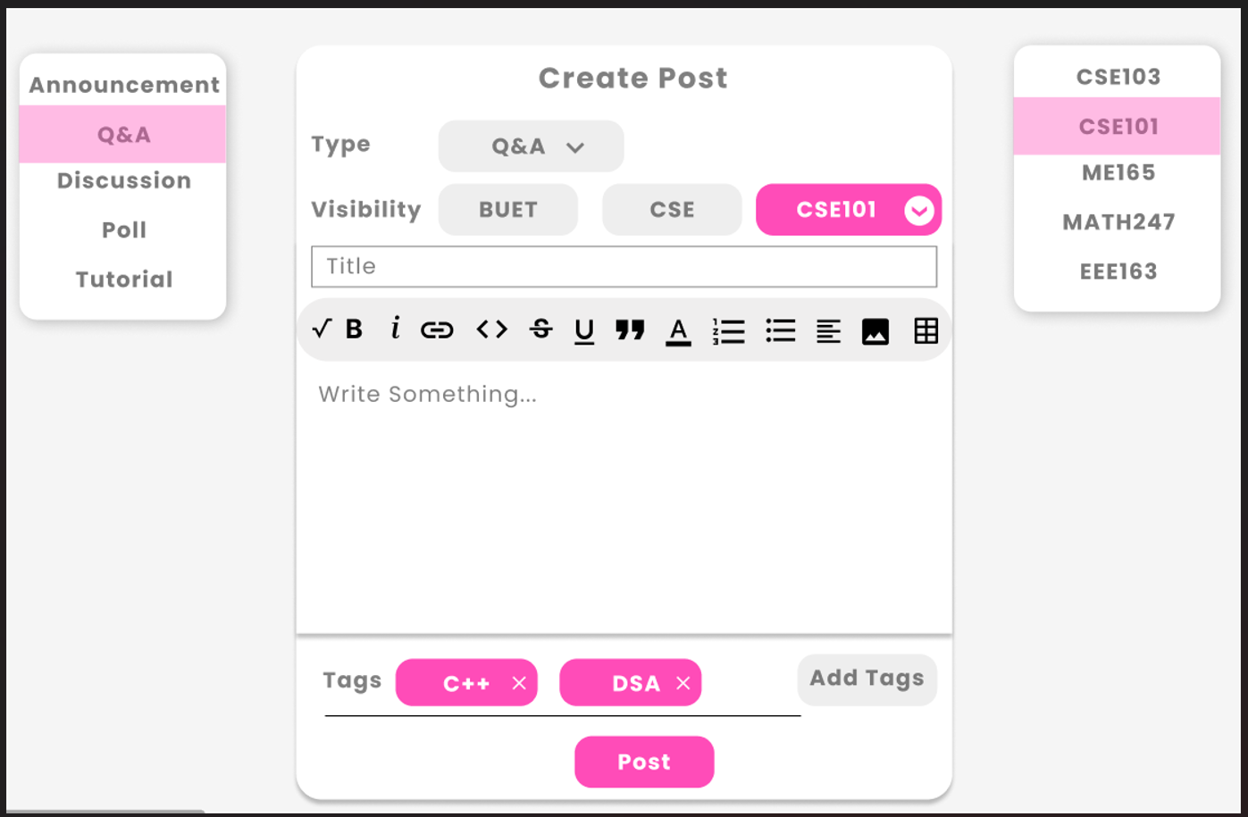
Create Post

Slide 14
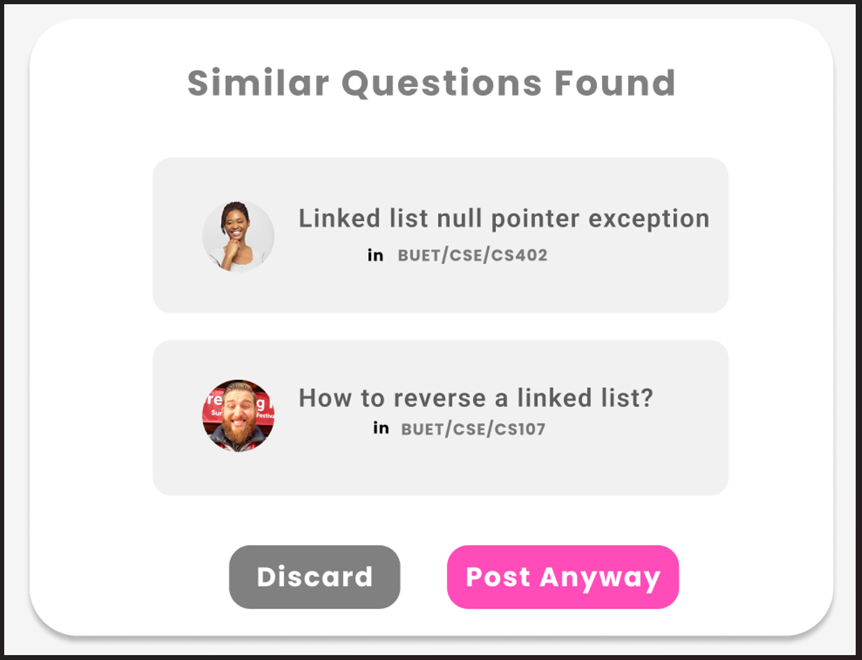
Similar Questions

Slide 15
Different types of posts

Slide 16
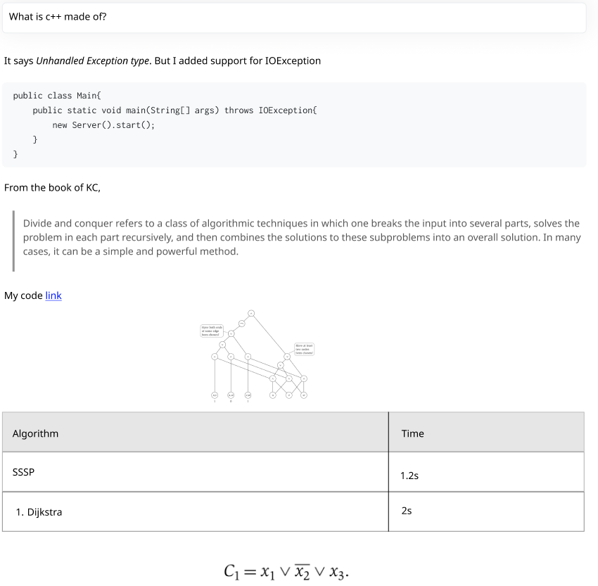
Q&A

Slide 17
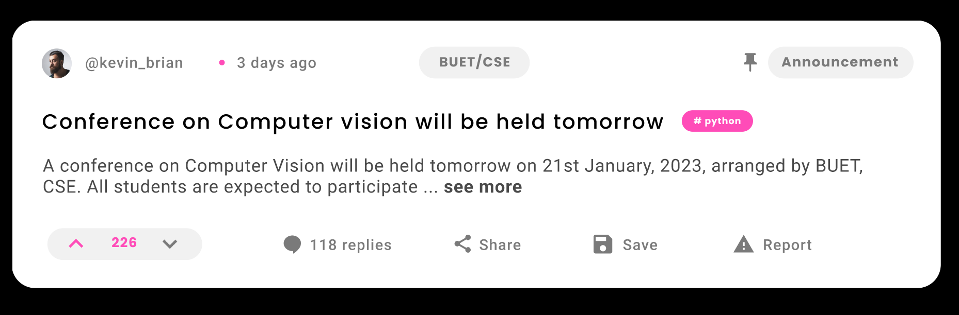
Announcement

Slide 18
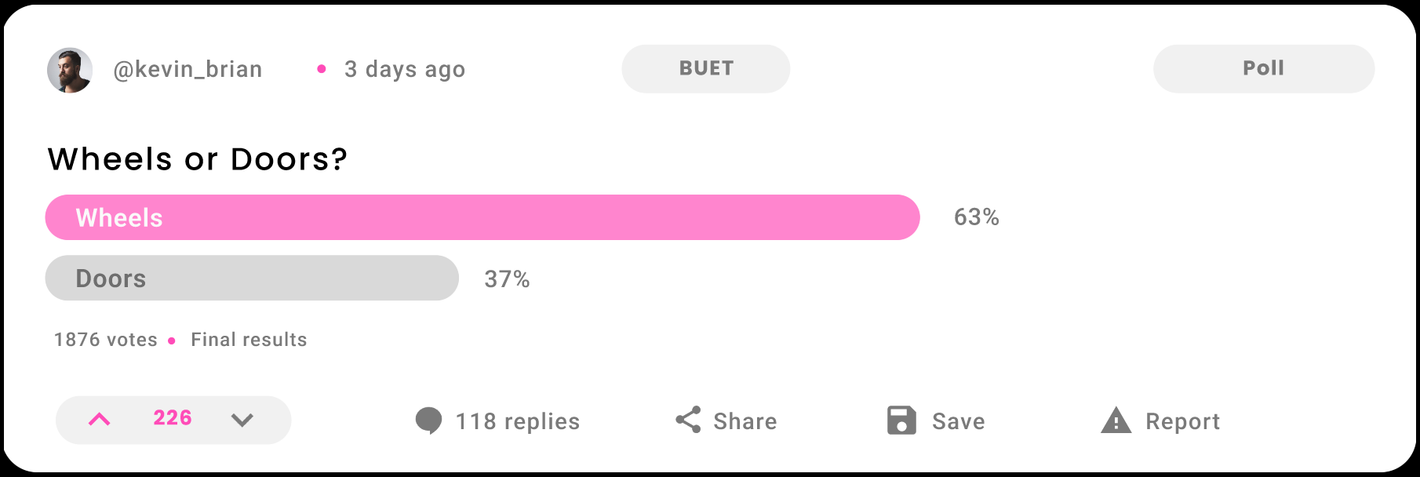
Polls

Slide 19
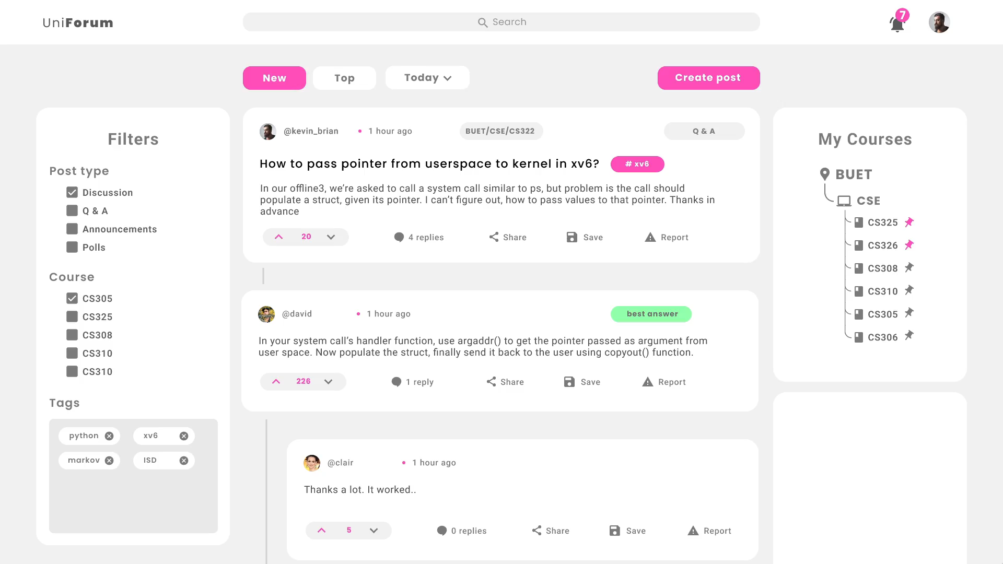

Slide 20
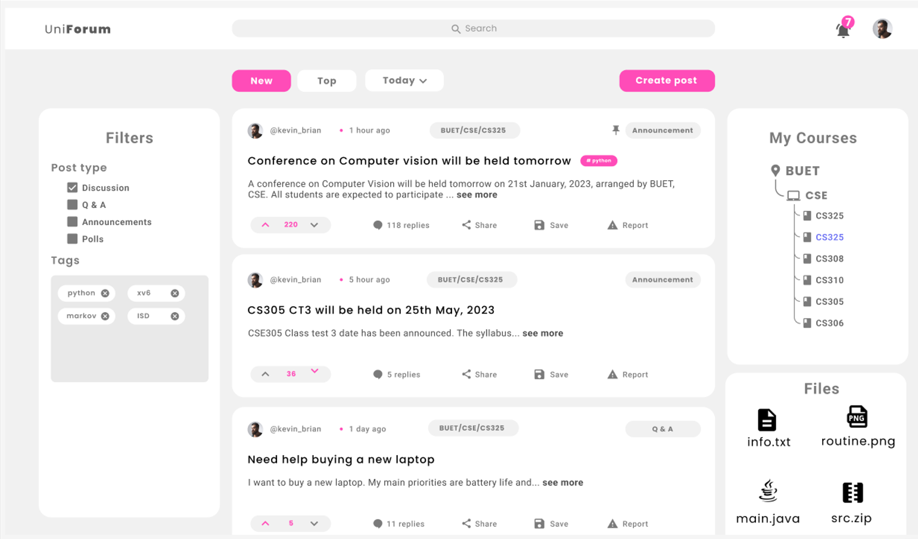
Course page

Slide 21
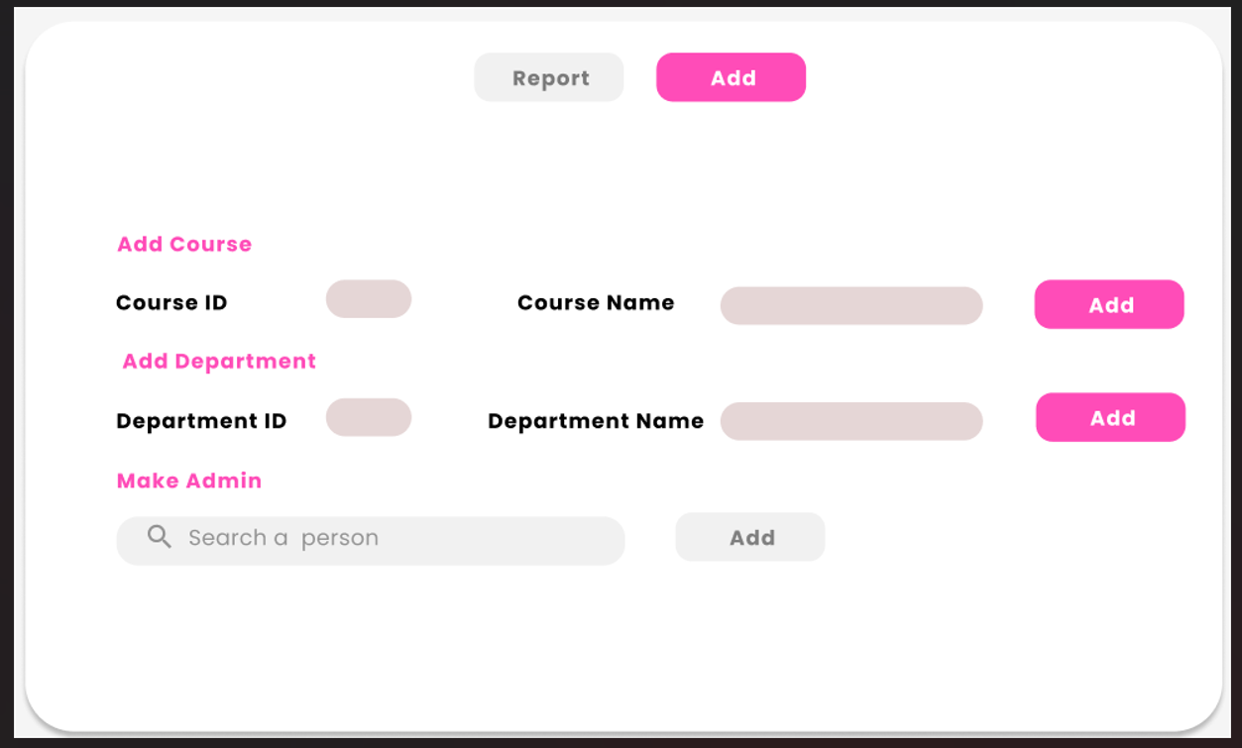
Admin

Slide 22
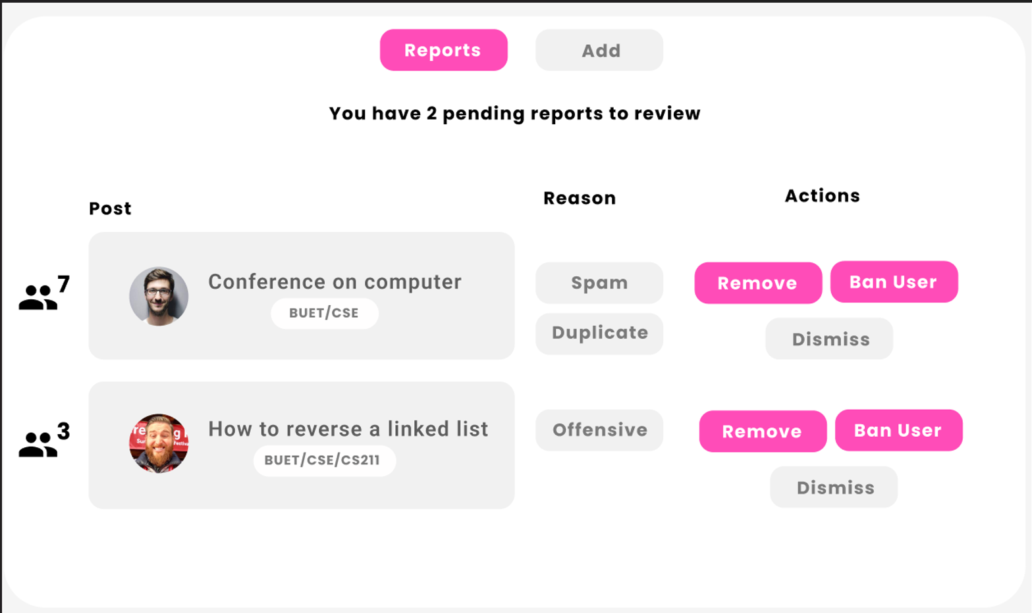
Report

